Slide 1
New Horizon college of Engineering MCA
Digital Steganography
1NH17MCA28 Dr. A.P Nirmala
Sandip Laha ASSOCIATE Professor
3rd Sem MCA
Sec-A

Slide 2
INTRODUCTION
Steganography, the word came from Greek word steganos, which means covered or secret, and the word graphy, it means writing or drawing. Steganography is the process or art of hiding (writing or drawing) secret information in some other information. It is to be written in such a way that only the intended recipients will be known about the existence of the message or information. Secrecy is very important to maintain in a large organization because as we know nowadays hackers become more intelligent and it becomes tedious.

Slide 3
PROJECT DESCRIPTION
In order to hide the information, many different carrier files format can be used, but images are the best because of their frequency on the internet. Although we have cryptography to transmit the secret messages, sometime it will give suspicion to the hackers and also it affects unintended users.
So to overcome the problem of cryptography, our project ‘Digital Steganography’ has built. In our project, we use multimedia data as an image as a covering medium. We can add or extract our secret information into or from the media. Also, we can send the message easily to other systems without any suspicion to others.

Slide 4
The receiver only is known about the information’s existence in the image and about the decryption idea.
The secret information can be hidden in an image file.
Encryption of the same message is done in the image file.
Retrieval of the message can also possible by decrypting the message.

Slide 5
LITERATURE SURVEY
Here As we stated cryptography can be used only in the situation where the message clearly was written and it also can be shown to others, but only the meaning of the message is obscured. Therefore the effective hackers might identify the meaning of the message which we don’t want to happen. So in the existing system maintaining secrecy will be very risky. Cryptography and Steganography can be used together or separately.

Slide 6
PROPOSED SYSTEM
In Digital Steganography, we overcome the problem of Cryptography that gives a solution to transfer secret information without any knowledge of the unintended user.
By using steganography we can easily hide the message in an image which can’t be distinguishable from the original one, so we can easily exploit the human perception.
Here we use an image as a multimedia medium to encrypt the secret information.
As we know the primary goal of steganography is to hide a secret information in some other data. So when we encrypt or decrypt the secret information we will always use a password.

Slide 7
Features of proposed system
It is very user-friendly for the intended user.
As we develop this project in Java, so it is platform independent.
The Flexibility of this project is very high.

Slide 8
TOOLS AND TECHNOLOGIES USED
Language : JAVA
Front End : Eclipse IDE Photon
Back End : Least Significant bit (LSB) and Triple data
Encryption Standard (3DES)

Slide 9
SOFTWARE CONFIGURATION
Operating system : Windows / Linux / Solaris
Front end : Java (jdk1.4.1 and above)
IDE : Eclipse Photon
Language used : Java Programming
Documentations : MS Word, Notepad SOFTWARE CONFIGURATION

Slide 10
HARDWARE CONFIGURATION
Processor : Intel® Core™ i3-5200 1.4 GHz
Hard disk capacity : 80GB or more
Display card : Intel® 512MB
Screen : 15.2” colour
Input Device : Keyboard and mouse etc.
Output Device : Monitor and printer

Slide 11
SYSTEM DESIGN ARCHITECTURE
The project consists of mainly five modules
Login: -
The user has to give a proper username and password, in order to get in the system. By giving only the correct username and password one can start the process of hiding information and encrypt the information. If the username and password are incorrect then it will show an error message.

Slide 12
Encryption: -
Encryption requires a medium or a file encrypting. It means it will cover the secret information in the covering medium. It will be done only by giving a secret password, which provides the security while converting the message. Therefore it will be difficult for hackers to decrypt. So as it is password protected while retrieving the message, the retriever has to give the correct password to get the secret information.

Slide 13
Decryption: -
Decryption requires a medium or a file decrypting. It means it requires the image that has already been encrypted. While decrypting the user has to enter the secret password. After providing the password and browsed the image user can decrypt the secret message that was encrypted. So without any knowledge of the unintended user, we can decrypt the information in this module.

Slide 14
Send Image: -
If you want to send the image to any other system, so you can do this by establishing a proper connection with both the sender and receiver. The receiver system’s IP address can be used to send the secret media. That we will use for future enhancements.

Slide 15
Exit: -
After completion of all the upper modules or at any time you can exit from the system by using the exit module.

Slide 16
ALGORITHM EXPLANATION
“Making steganography Medium”
“Getting secret information from steganography medium”

Slide 17
Making Stegano Medium
Step 1: Start the process
Step 2: Enter the Secret Information
Step 3: Enter the User Code
Step 4: Load a multimedia data, here it is an Image
Step 5: Creation of Secret Code by using user code + secret information
Step 6: Hiding secret information with its security into the multimedia data
Step 7: A message box showing the secret key will appear
Step 8: Stop the process

Slide 18
Extracting secret information from Steganography medium
Step 1: Start the process
Step 2: Enter the Secret Code
Step 3: Enter the Steganography Medium
Step 4: Extract secret information from steganography medium by using secret code.
Step 5: Stop the Process

Slide 19
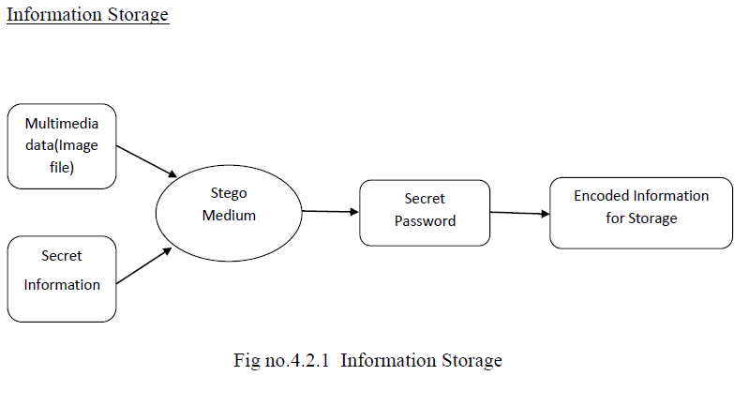
DATA FLOW DIAGRAM

Slide 20
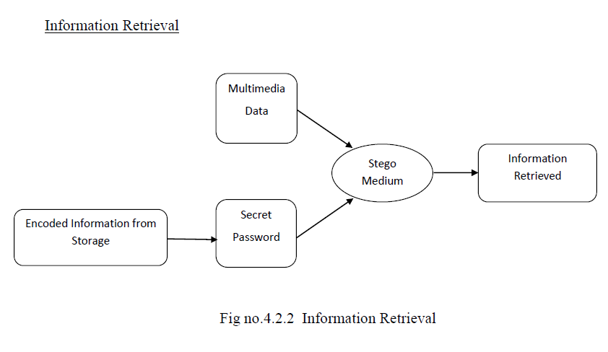

Slide 21
SCREEN SHOTS
The Login page allow you to enter into the system, It requires proper username and password.

Slide 22
After successfully login we get the Home page of our project.
It has three option like Encryption, Decryption and Send Image button. We can select any one of this and can perform the corresponding operation.

Slide 23
In Encryption module we need to select source as an image from the system, then we have to type our secret messages for encryption.

Slide 24
Here it will ask a secret password that we have to give for more security purpose, which will only know by the intended user.

Slide 25
At the receiver end the user need to give the same password as given at the time of encryption. Therefore it will enter into the decryption process.

Slide 26
Here you need to select the encrypted image to decrypt, so you will get the secret code send by the sender.

Slide 27
In future, we can send the image to another system by establishing secure connection or using IP address of the particular system.

Slide 28
CONCLUSION
Nowadays it’s a big problem to secure your personal information from hackers. We are seeing many Organizations such as public or private as well as government agencies also fetching the problem of secrecy. So maintaining secrecy is very important.
GUI based programs are always user-friendly. Our project is also built on Java Swing and other GUI based platform that provides maximum interaction with the user. In our project, hidden messages can easily be encrypted and also be transmitted to the intended user. That won’t create any suspicion to the unintended user. Therefore decryption of the message can be done only by the knowing recipients.
The technology used in our project Steganography is very easy to use and user-friendly, but very difficult to hacked or detect errors. So here we can conclude that it is a very secure medium in order to transfer secret information to the intended user, without giving any suspicion to other.

Slide 29
FUTURE ENHANCEMENTS
As we implemented our project Digital Steganography to encrypt and decrypt the messages in a multimedia as an image, therefore we can extend our project in the following way-
This project can be further extended by adding video files as a covering medium.
By using more technology we can increase the capacity.
We can add other algorithms in it, as a choice of choosing algorithms as far as the user requirements.
In future, the most frequent use of Steganography will be in the context of “Digital Watermarking”.

Slide 30
BIBLIOGRAPHY
Books
[1]. Java Fundamentals, A comprehensive Introduction by Herbert Schildt and Dale Skrien, Tata McGraw Hill, Edition 2013.
[2]. Java Programming by Hari Mohon Pandey, Pearson Education, 2012.
[3]. Java The Complete Reference (Ninth Edition) By – Herbert Schieldt, Tata McGraw Hill, Edition 2014.
[4]. David & Deitel (1999), Java How to program Introducing Swing, Prentice Hall.

Slide 31
Journals
Natarajan Meghanathan and Lopamudra Nayak, Steganalysis Algorithms for Detecting the Hidden Information in Image, Audio and Video Cover Media, Jackson State University, 1400 Lynch St., Jackson, USA.
Luis von Ahn and Nicholas, Steganography, Carnegie Mellon University, Pittsburgh, USA.
Web Sites
http://java.sun.com
http://www.javaworld.com
https://www.geeksforgeeks.org/java

Slide 32
Thank you

